Slide 1
Story of SJHS
By: Julia Jones

Slide 2
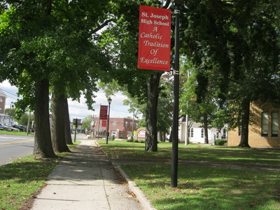

Slide 3
In this photo, I had taken a picture of not only part of St. Joseph High School grounds, but particularly of the St. Joseph banner that reads, “St. Joseph High School A Catholic Tradition of Excellence”. These banners show what St. Joseph is all about.

Slide 4
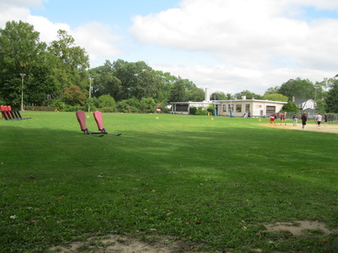

Slide 5
In this next photo, I felt this picture showed importance because it not only stands for our football teams practice field, but also for all the other sports that put their hard work and dedication into the sports that each individual plays for St. Joseph.

Slide 6
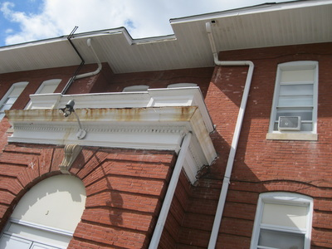

Slide 7
This photo taken is of the Red Brick Building. This building has different classrooms inside that consists of guidance, religion classes, and other activities. Because this building is so old, it shows great importance and an impact on our school throughout the many teachers and students that have taught and studied in here.

Slide 8
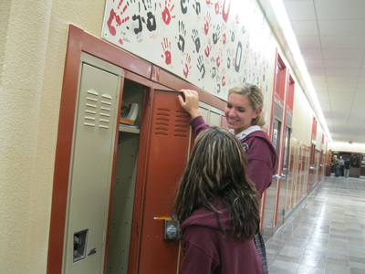

Slide 9
This is a photo taken of two students. This picture really shows how St. Joseph High School students interact and display the Catholic faith taught here.

Slide 10
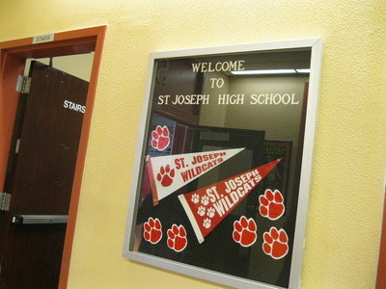

Slide 11
In this photo, it reads, “Welcome to St. Joseph High School”, showing how welcoming our school is to newcomers and guests in our school.

Slide 12
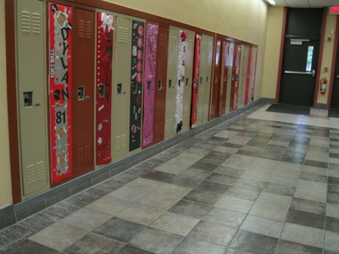

Slide 13
The decorated lockers shows our pride & school spirit throughout the hallways.

Slide 14
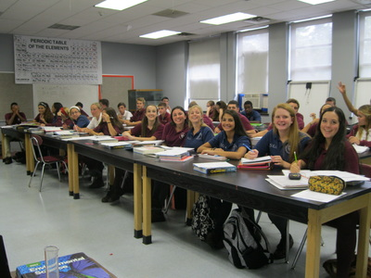

Slide 15
A picture of students in Chemistry class always learning something new and exciting. As well as every other class.

Slide 16
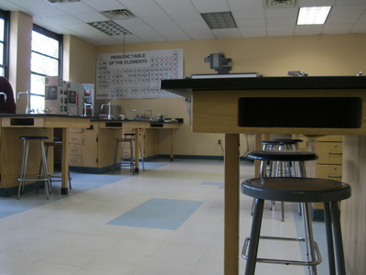

Slide 17
This is a photo of one of classrooms that are used for any science classes. Many fun projects, experiments, and labs go on in these rooms.

Slide 18
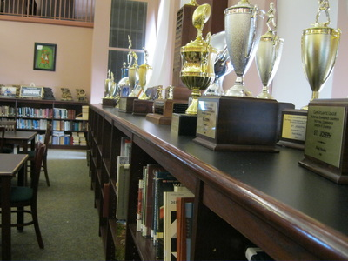

Slide 19
These trophies symbolize how well our sports programs are. Each sport represents St. Joseph in a good way which shows our hard work and dedication.

Slide 20
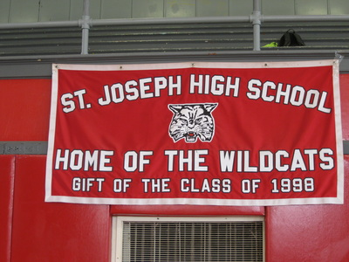

Slide 21
Lastly, the banner held in our gym is also very old. This banner tells that it was a gift from the class of 1998. It represents our mascot, The Wildcat.

